Slide 1
Paper Title
Authors
Affilliation

Slide 2
Introduction
Mauris orci mi, varius id diam id, egestas auctor enim. Praesent ut massa nibh. Duis in et purus neque, facilisis cursus unus di ultrices vel, ullamcorper ac et augue. Donec semper lorem vitae urna pulvinar, et in congue massa.

Slide 3
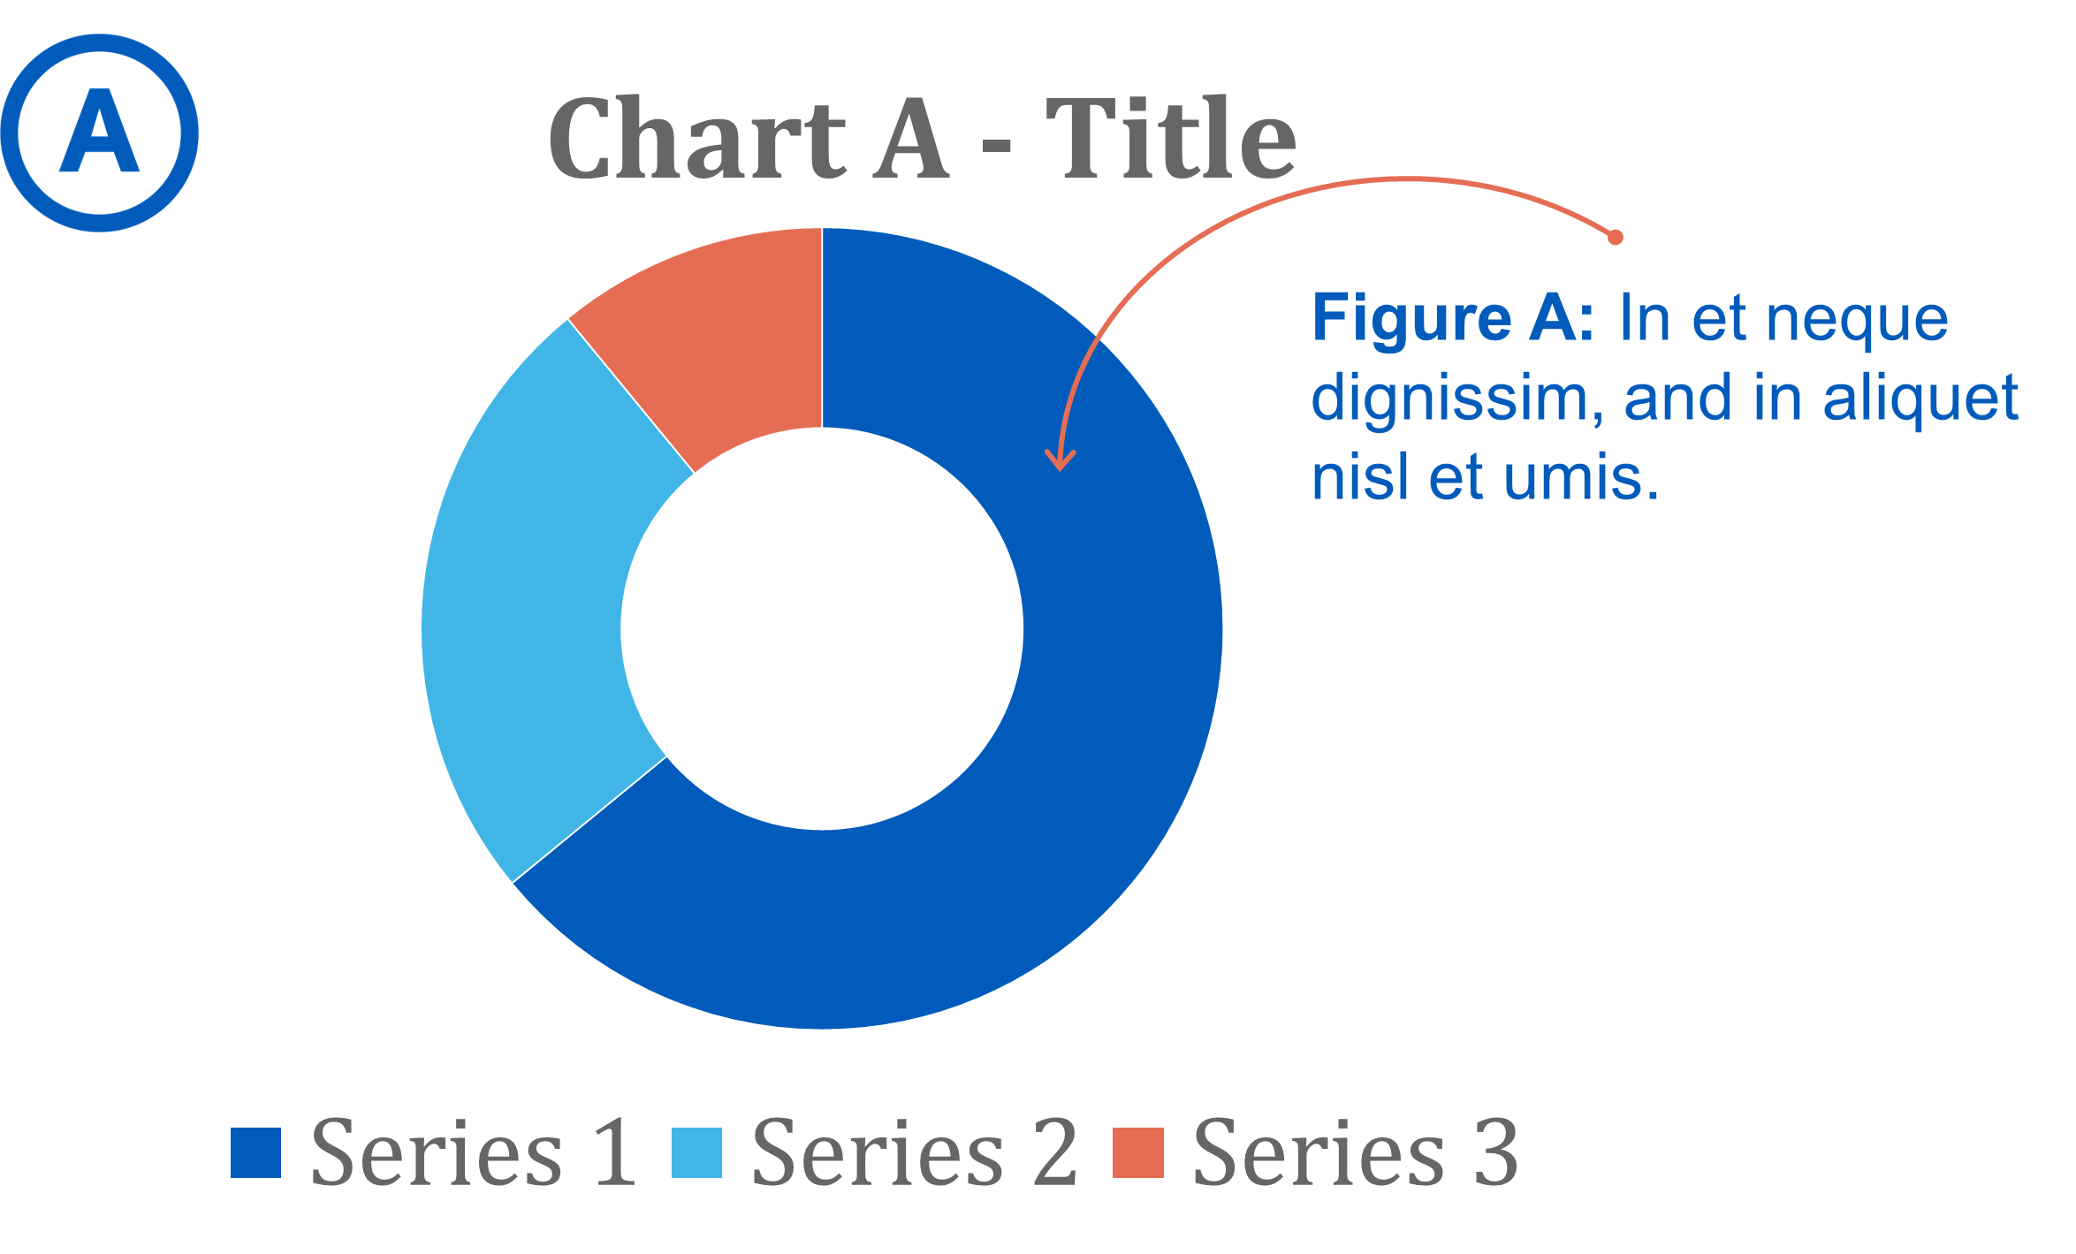

Slide 4
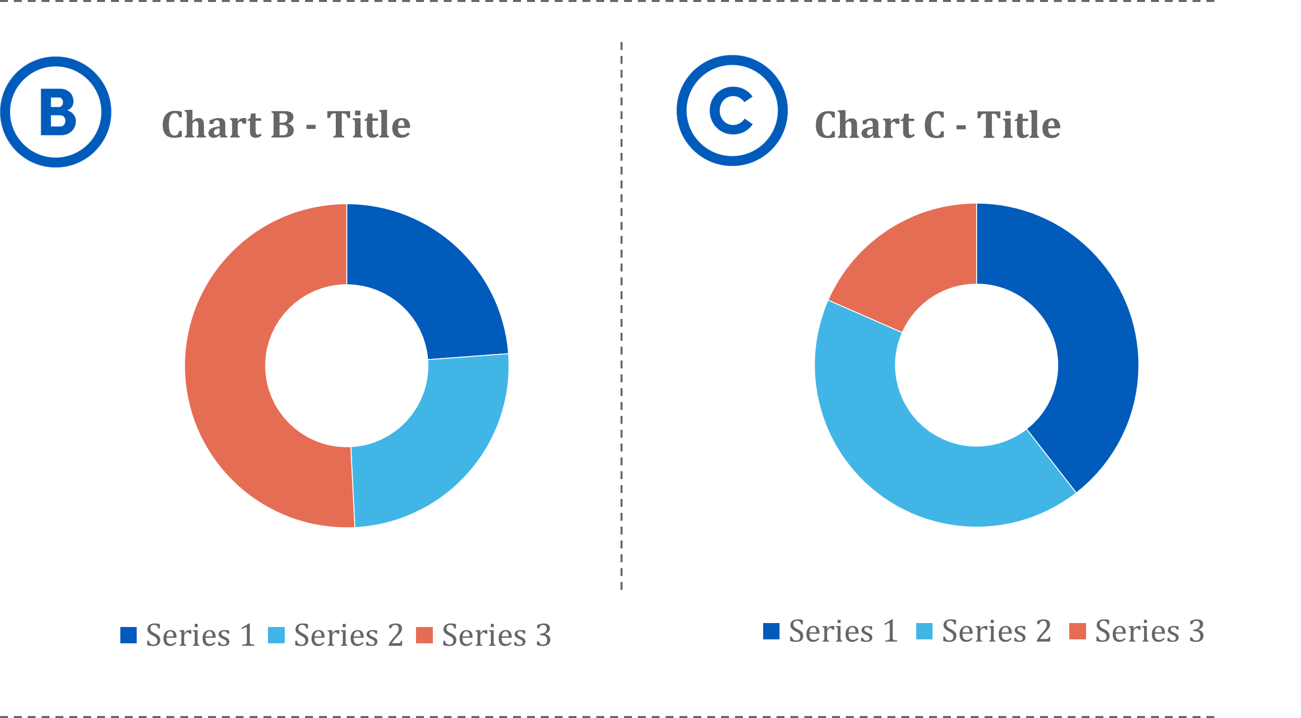

Slide 5
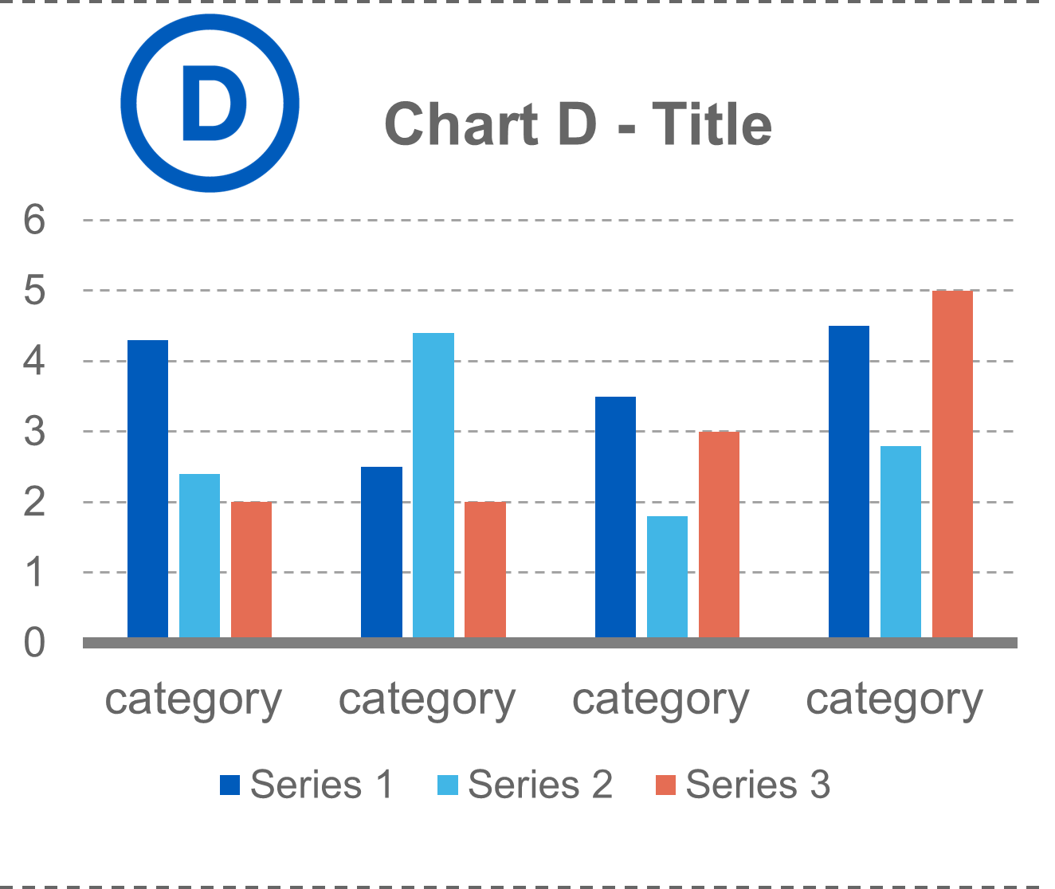

Slide 6
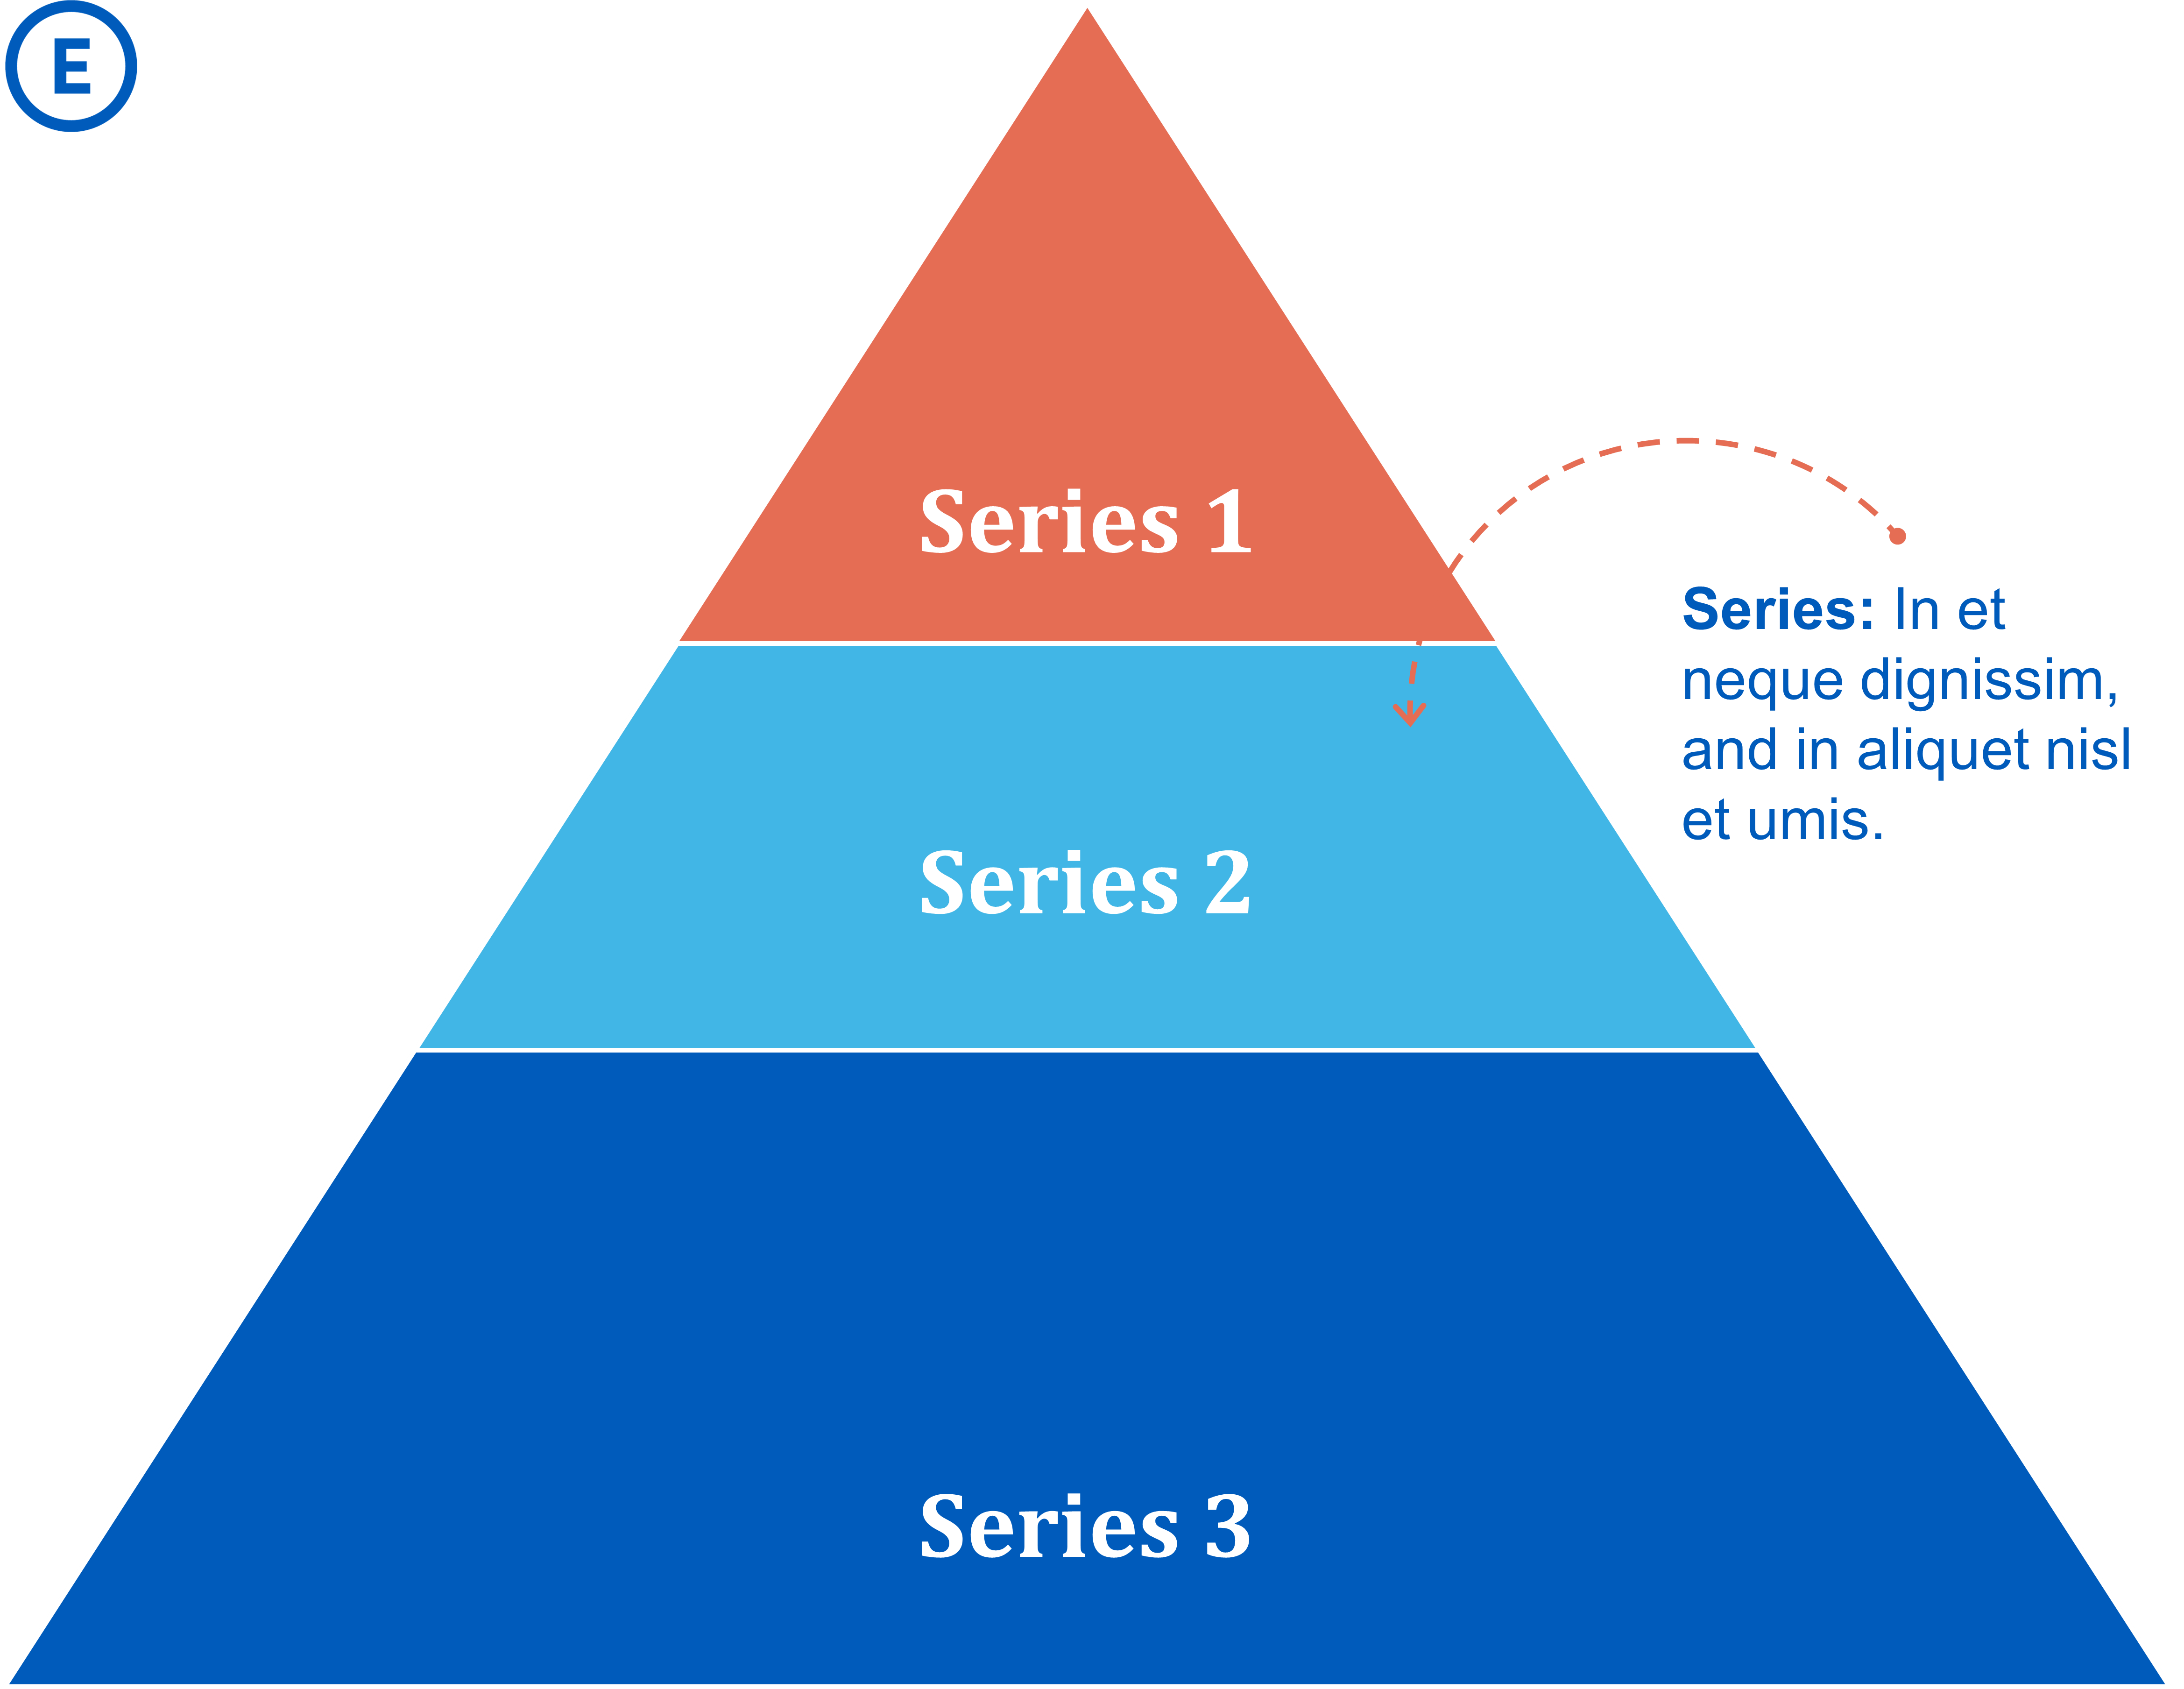

Slide 7
Table 1 - Title
8.01 | 7.99 | 5.77 | 6.44
4.50 | 3.11 | 9.55 | 1.12
6.15 | 8.00 | 6.18 | 5.65
8.21 | 2.16 | 3.11* | 7.17
3.00 | 9.70 | 10.50 | 4.45

Slide 8
The End

